Slide 1
TASK MANAGEMENT SYSTEM
DATE
9/05/2024
21CSC205P
DATABASE MANAGEMENT SYSTEM
BY
MRISHIKA DHINAKARAN
RA2211026050061

Slide 2
PROBLEM STATEMENT
In today’s dynamic business landscape, effective project management stands as a cornerstone for success. Coordinating tasks, monitoring progress, and ensuring seamless communication among team members are critical elements for achieving project goals efficiently. Leveraging technological solutions can significantly streamline these processes, and one such robust solution is the Task Management System developed in PHP and MySQL.

Slide 3
USES OF THE SYSTEM
A task management system is a digital tool designed to organize, track, and prioritize tasks within projects or workflows. It streamlines collaboration, enhances productivity, and ensures accountability by assigning tasks, setting deadlines, and providing progress updates. By centralizing task-related information and facilitating communication among team members, it promotes efficiency and enables effective project coordination from inception to completion.

Slide 4
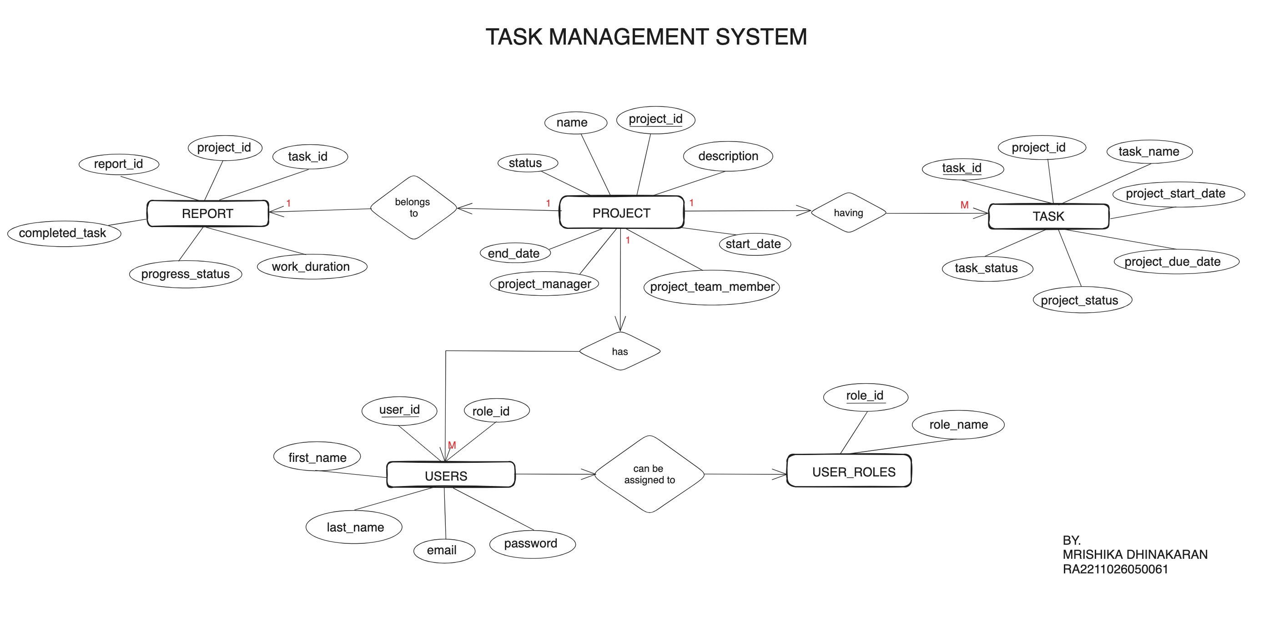
ER DIAGRAM

Slide 5
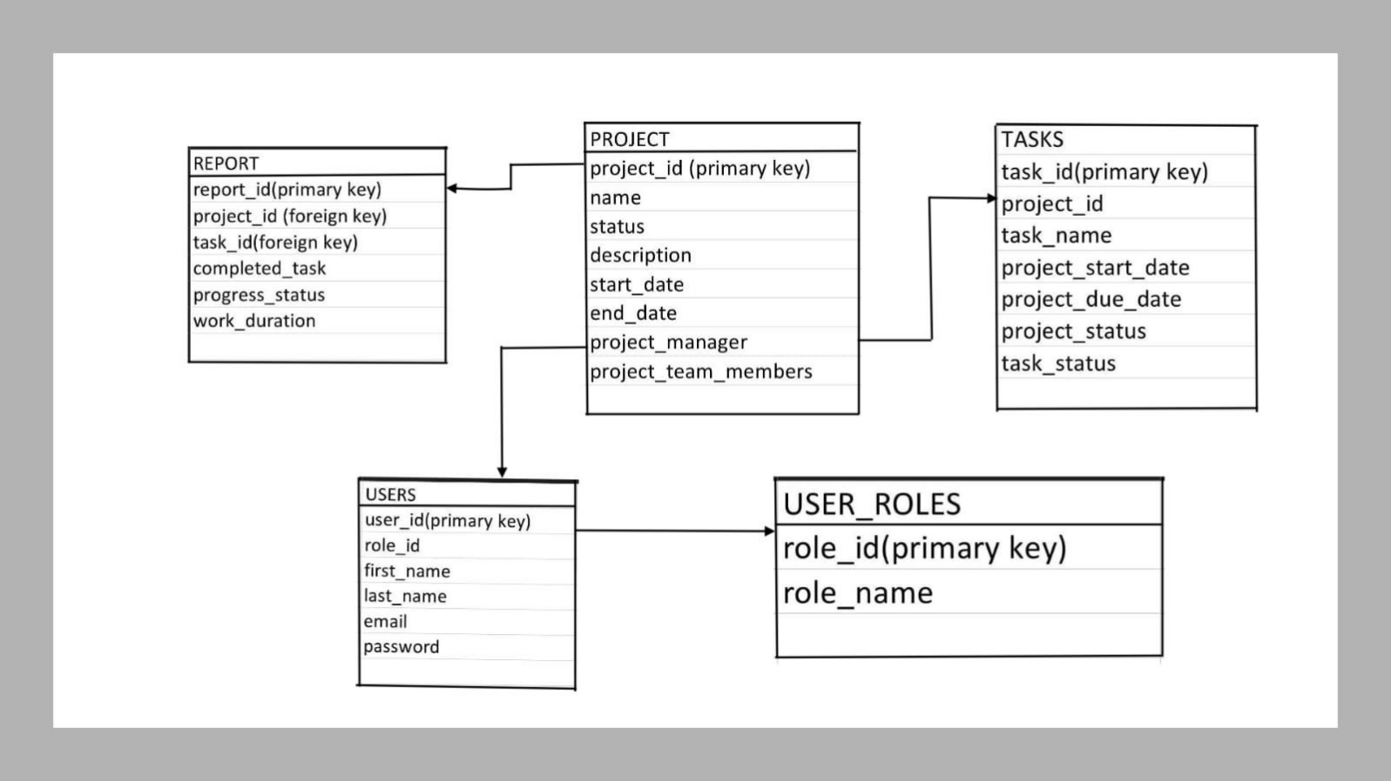
RELATIONAL MODEL

Slide 6
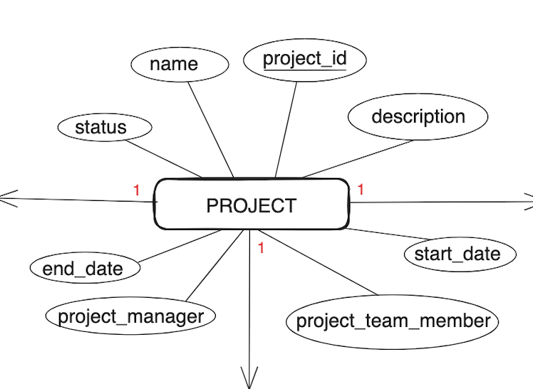
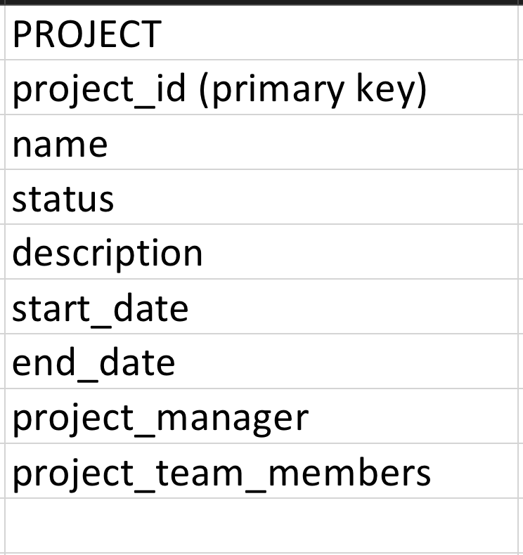
TRANSFORMATION OF ER TO RELATIONAL MODEL

Slide 7
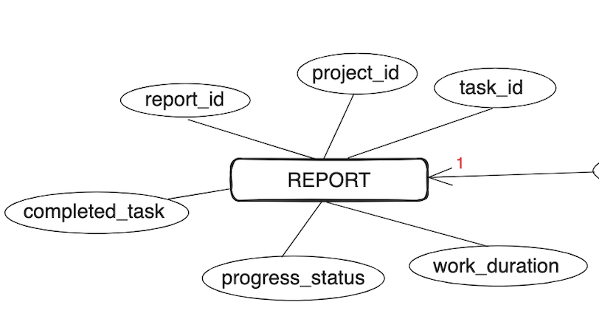
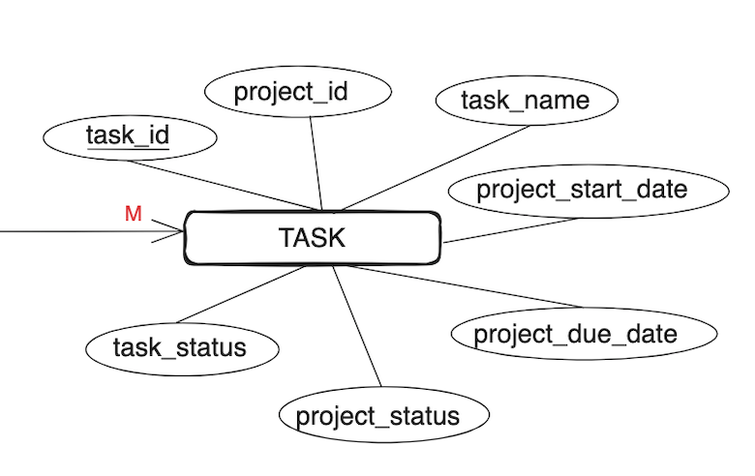
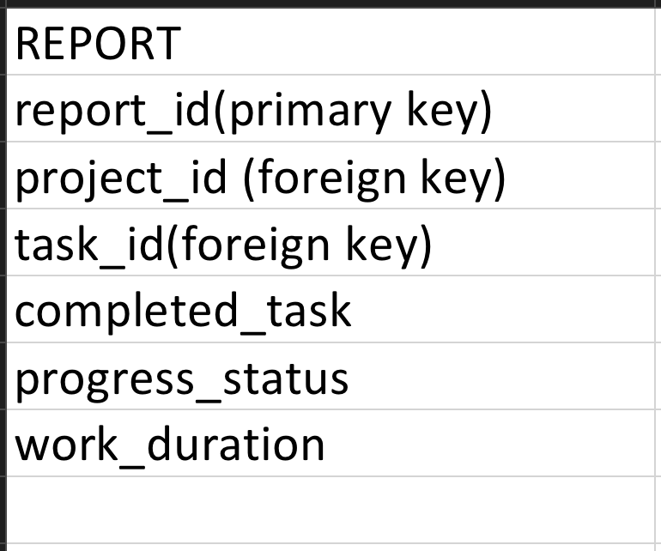
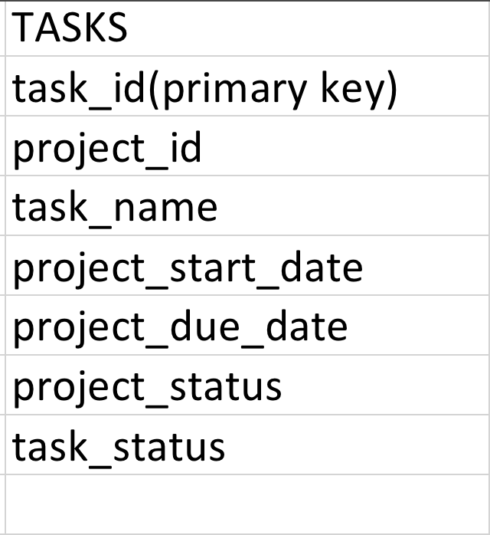

Slide 8
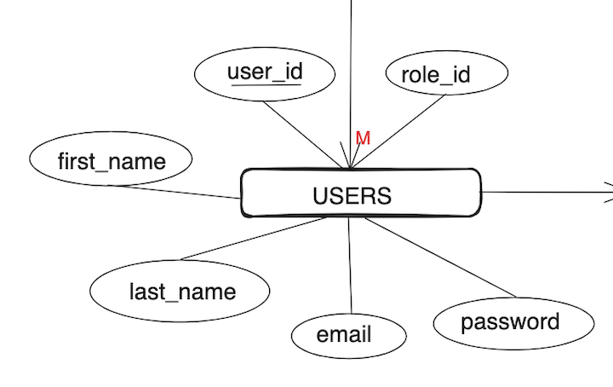
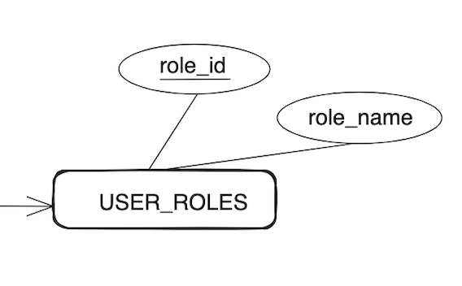
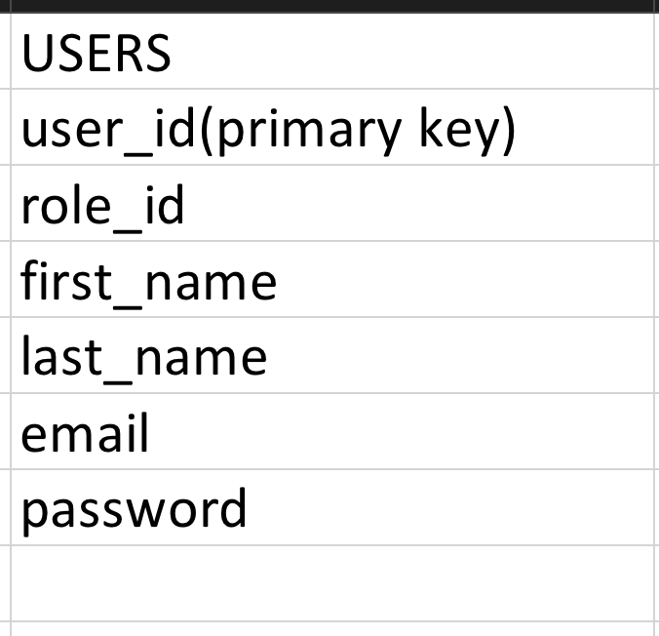
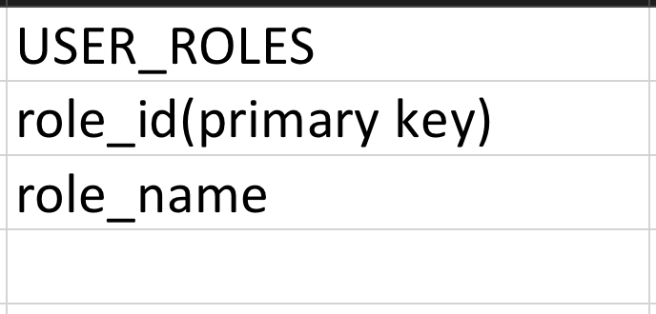

Slide 9
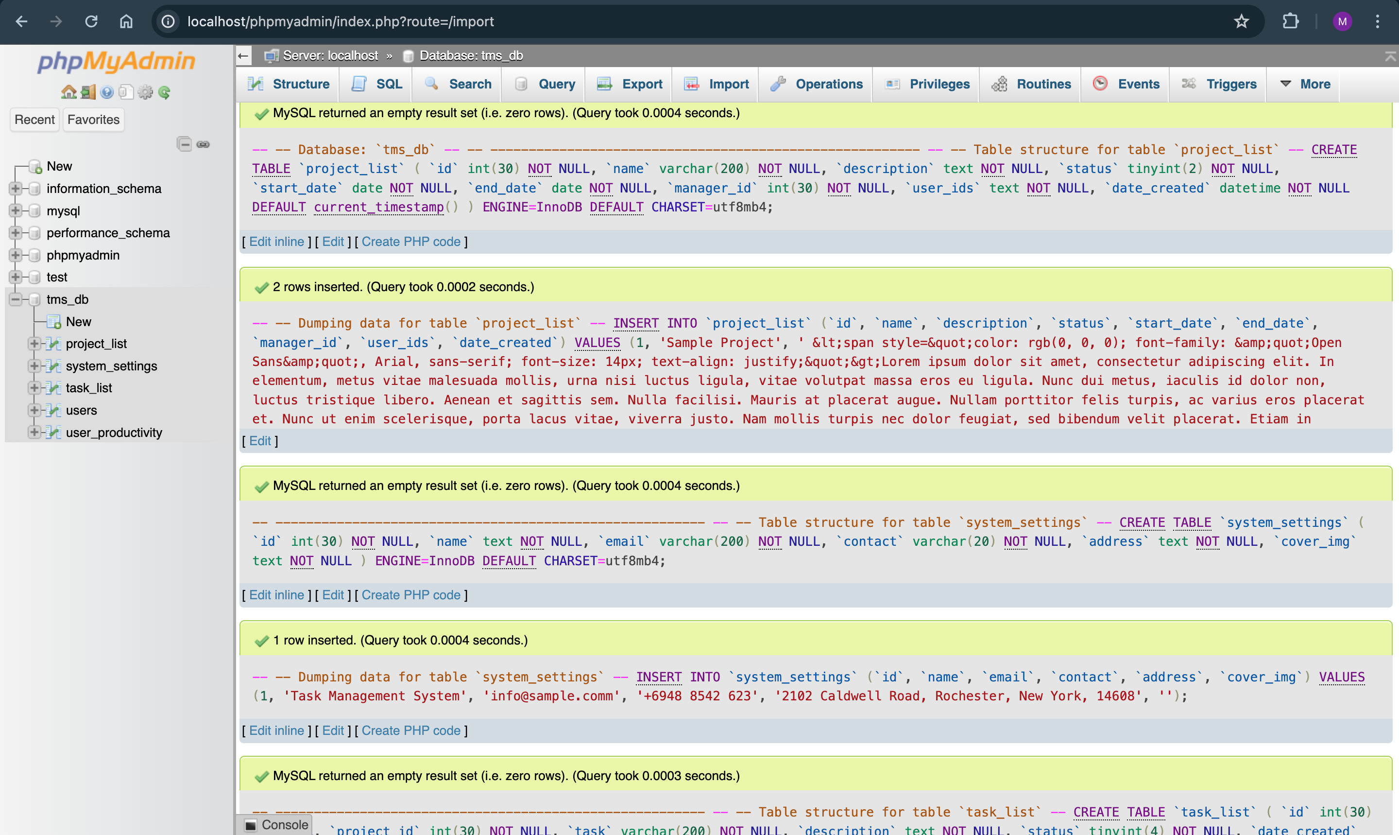
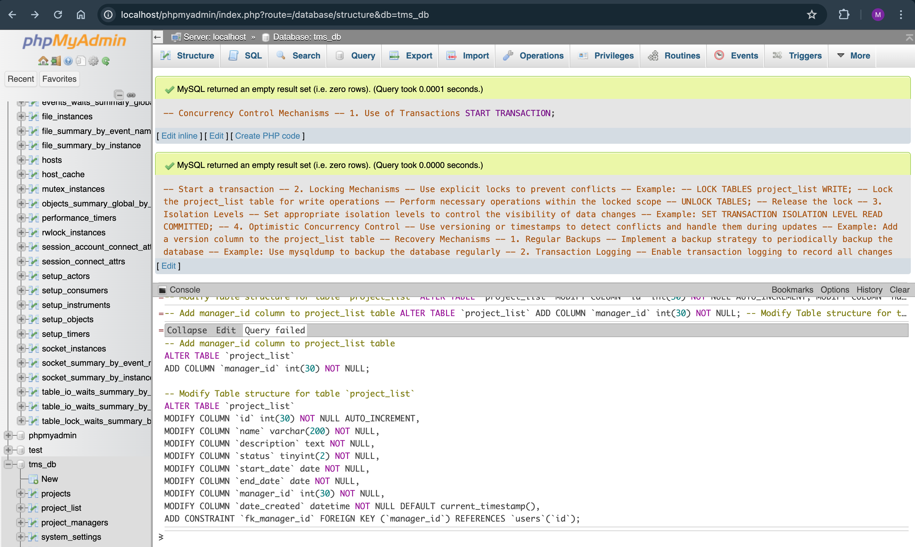
QUERY EXECUTION

Slide 10
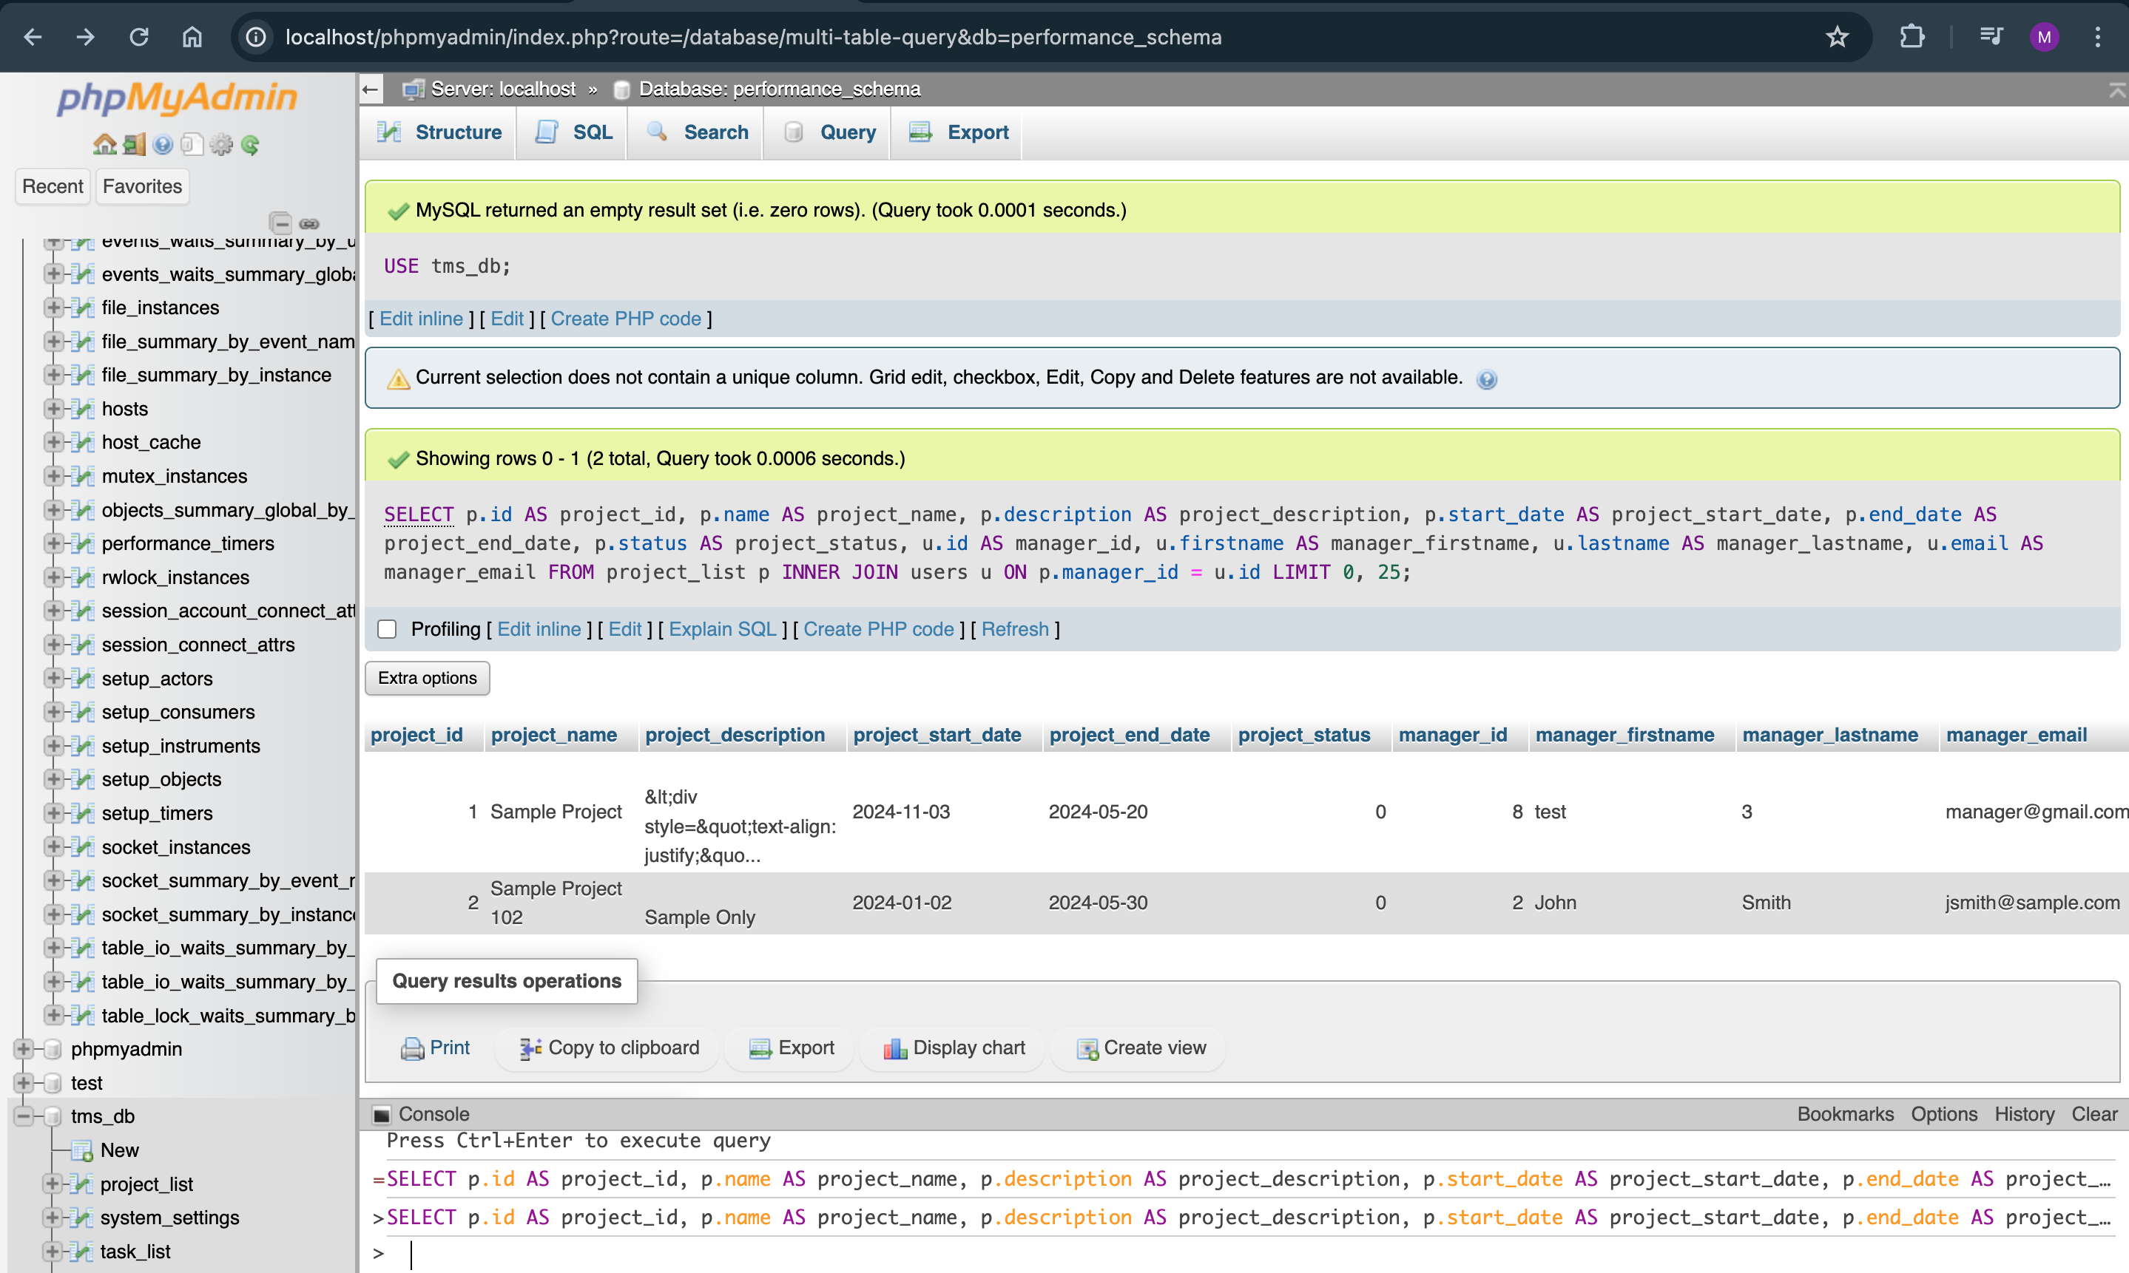
IMPLEMENTATION OF NORMAL FORMS

Slide 11
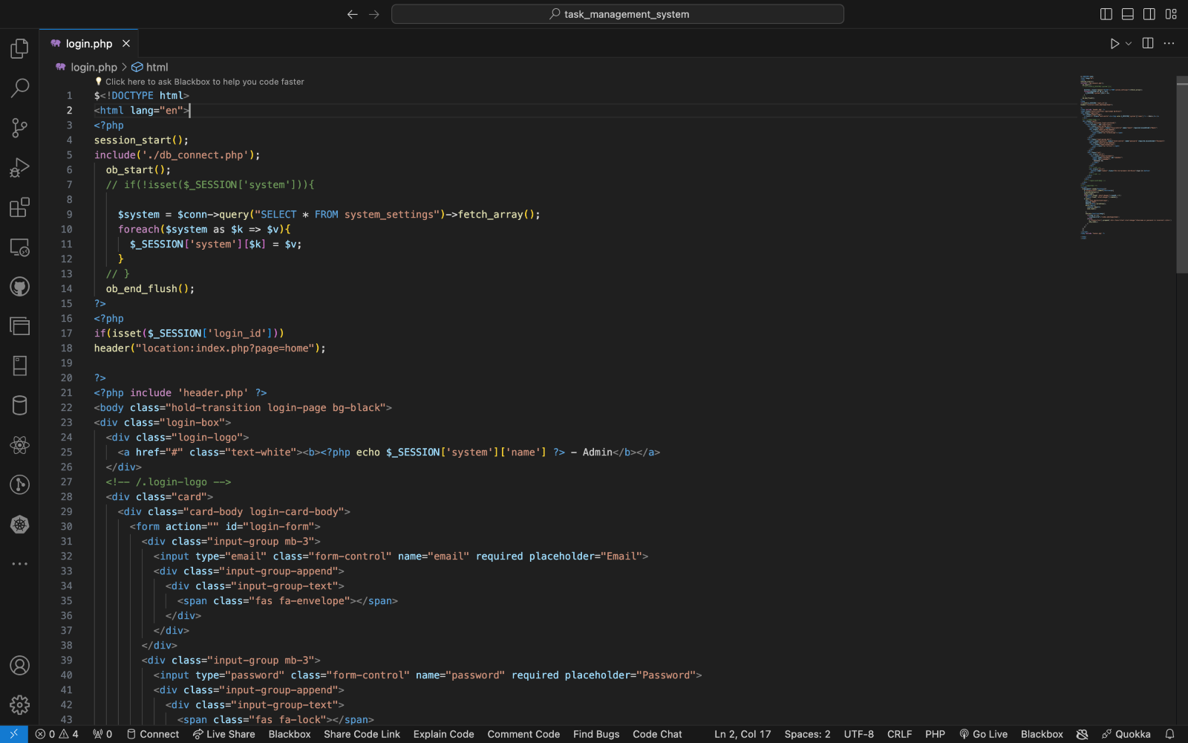
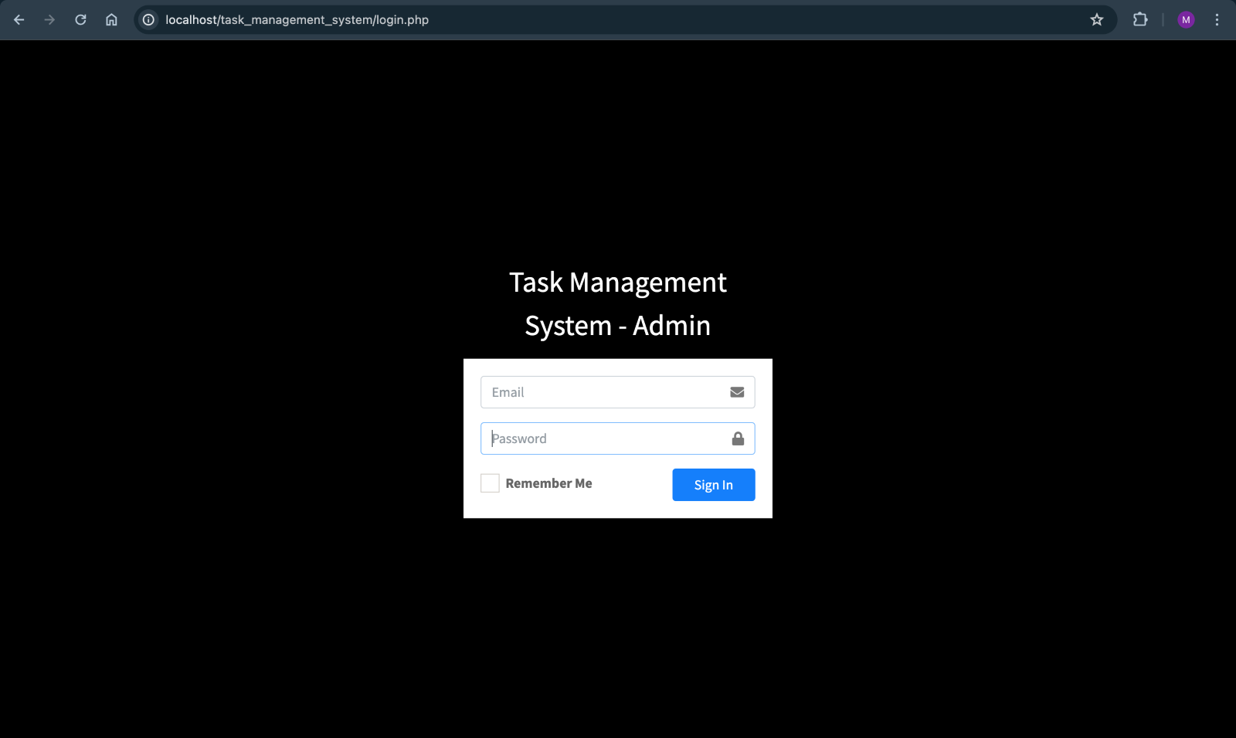
FRONT END DESIGN
LOGIN PAGE:

Slide 12
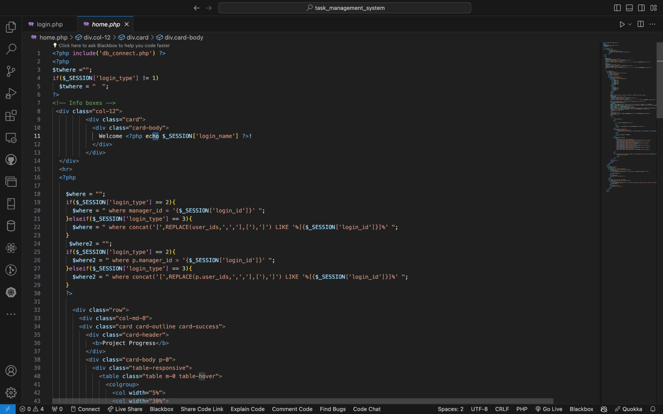
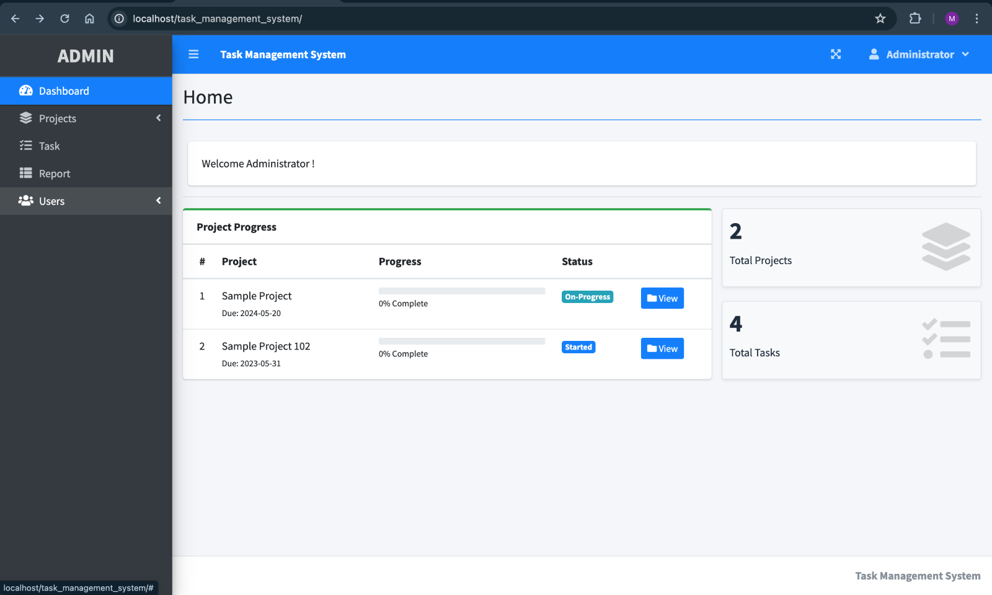
HOME PAGE:

Slide 13
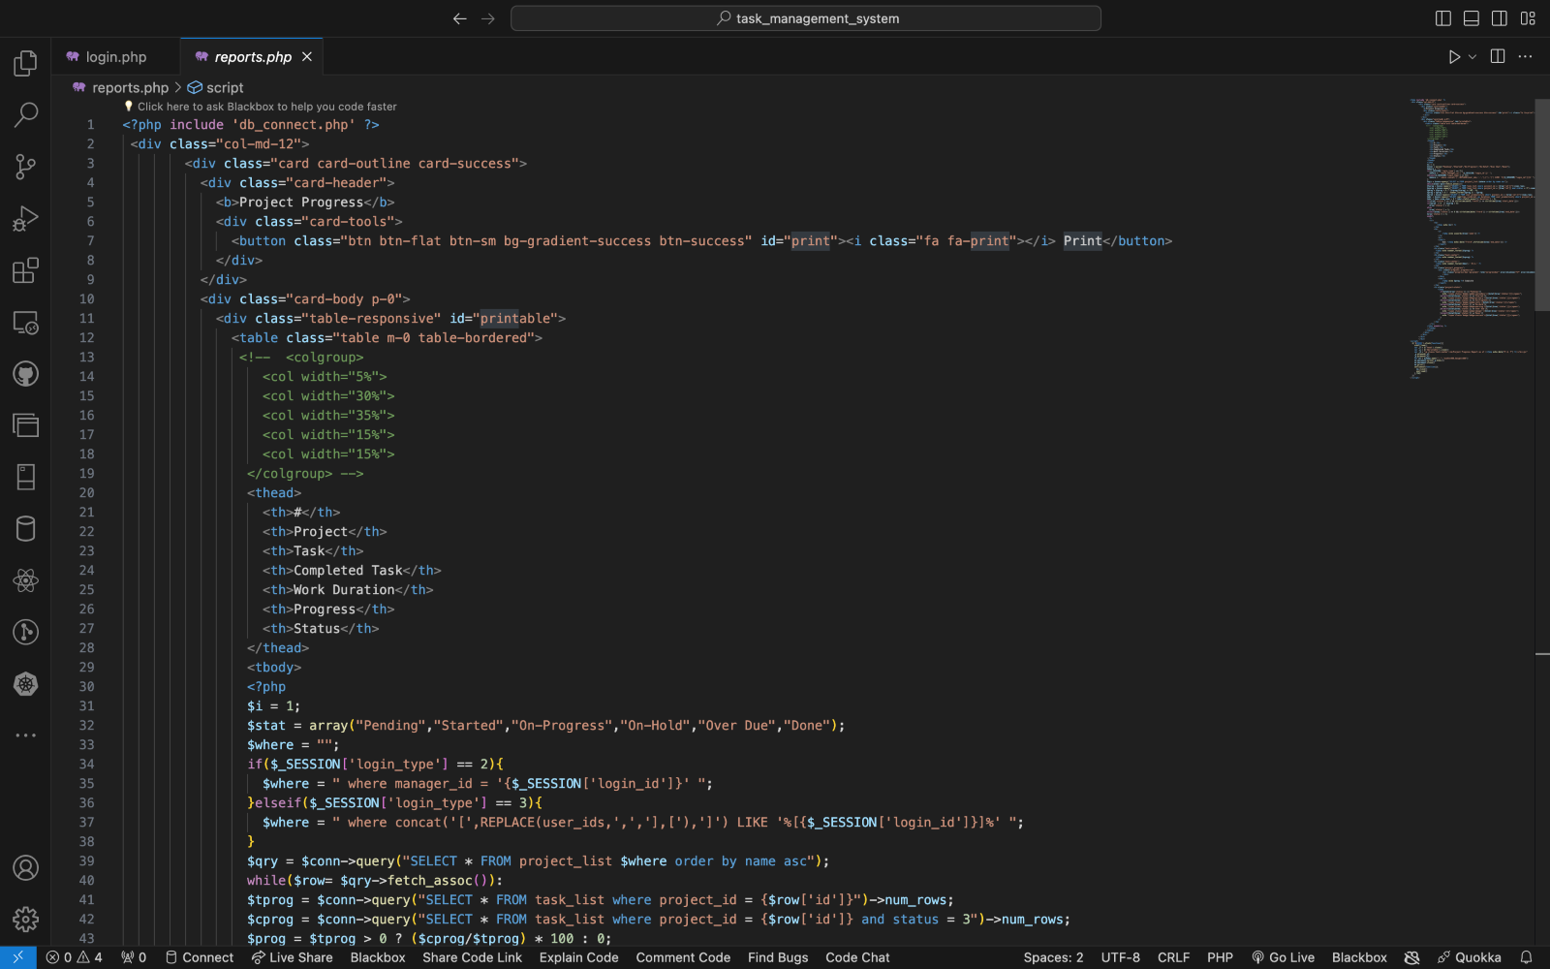
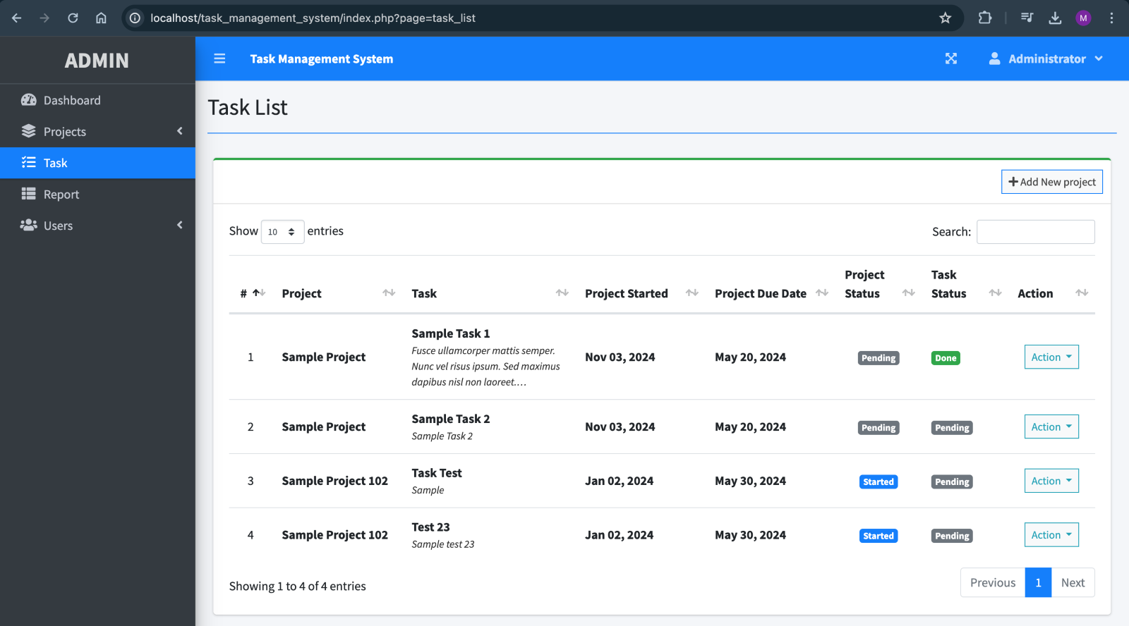
TASK PAGE:

Slide 14
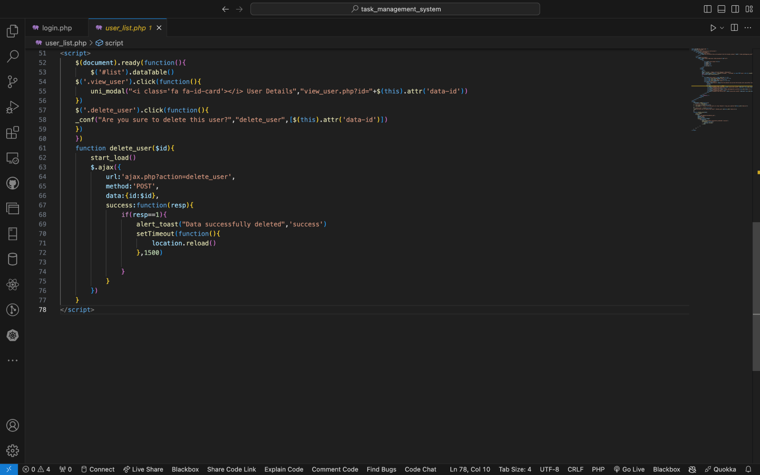
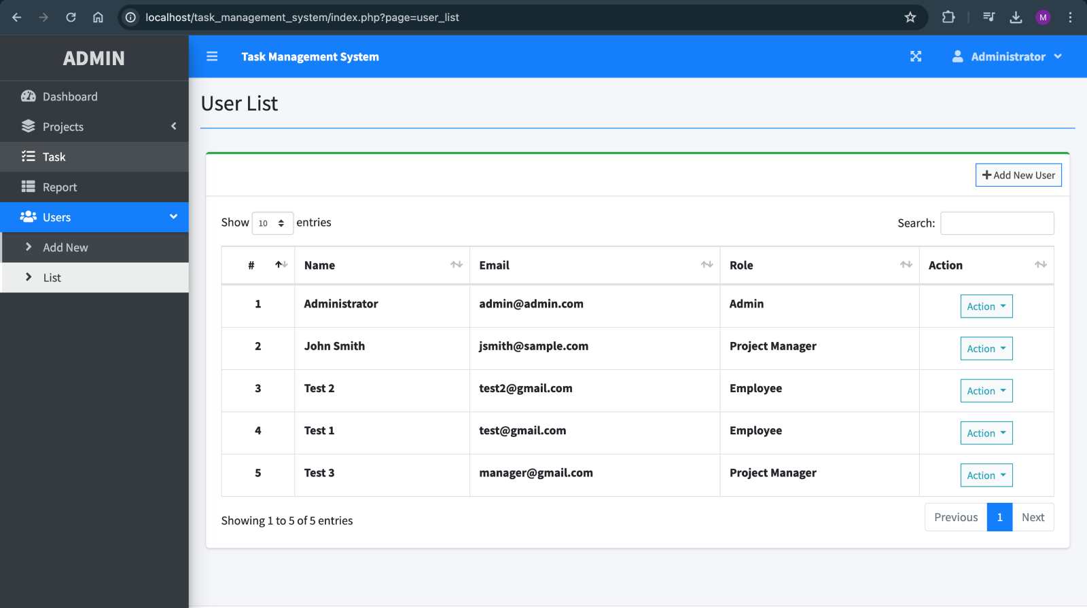
USER LIST:

Slide 15
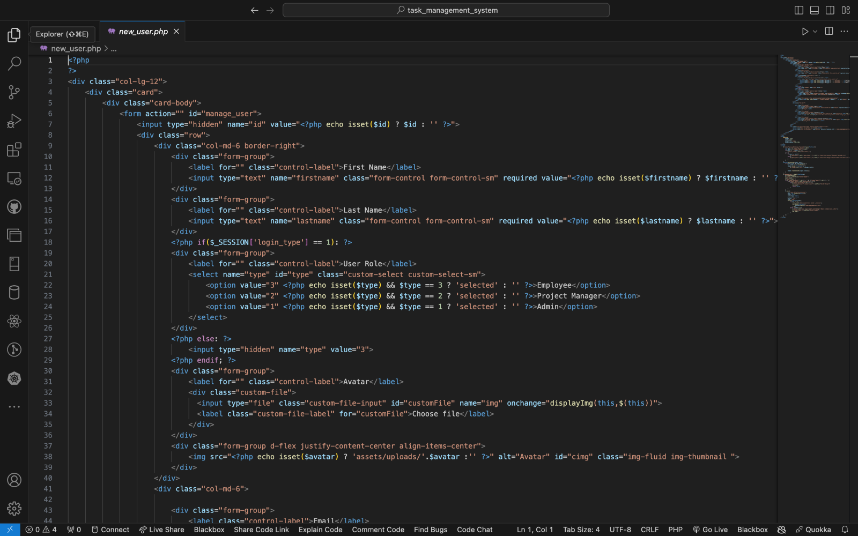
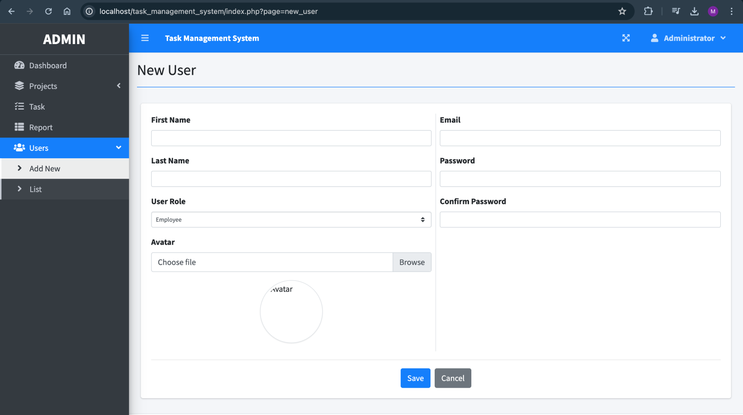
NEW USER PAGE:

Slide 16
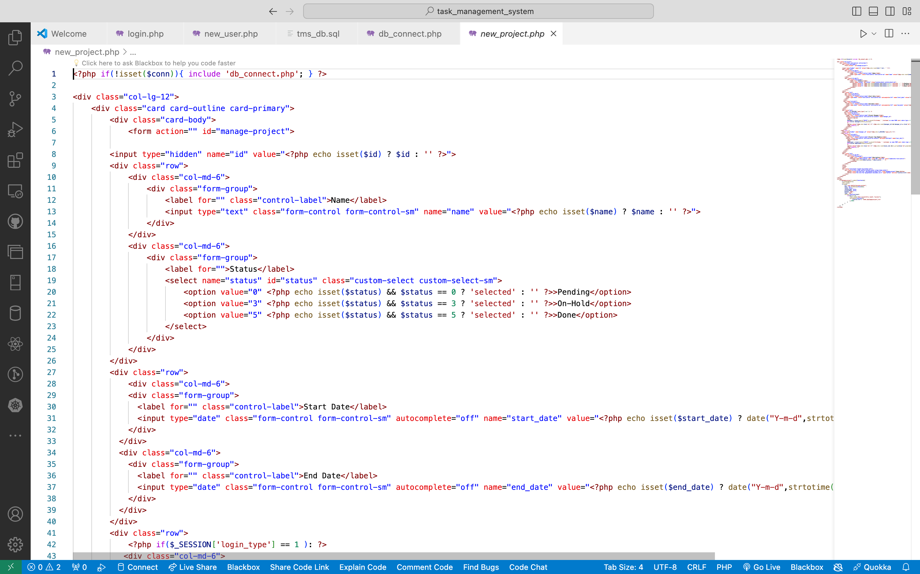
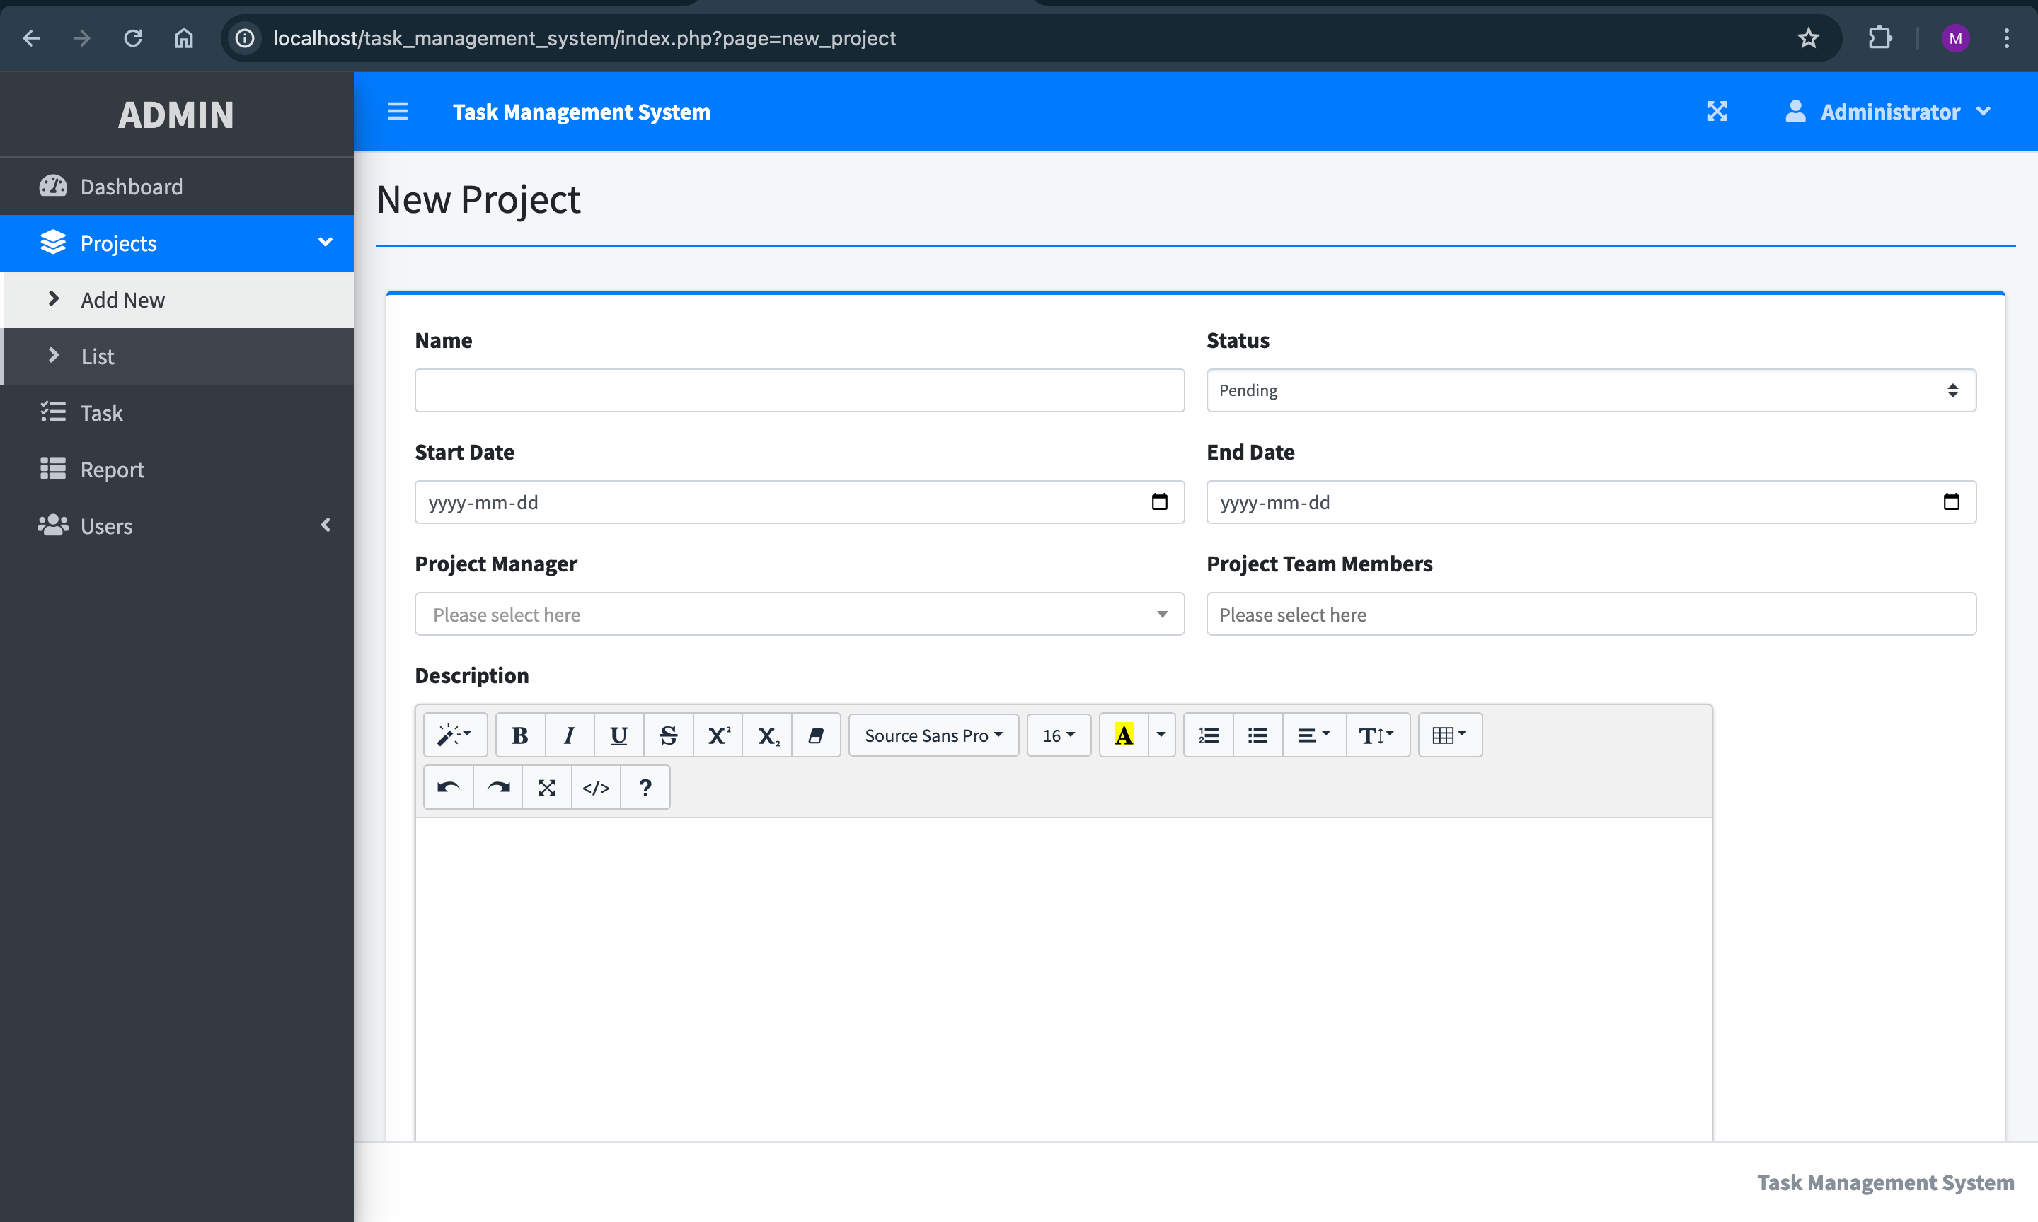
NEW PROJECT PAGE:

Slide 17
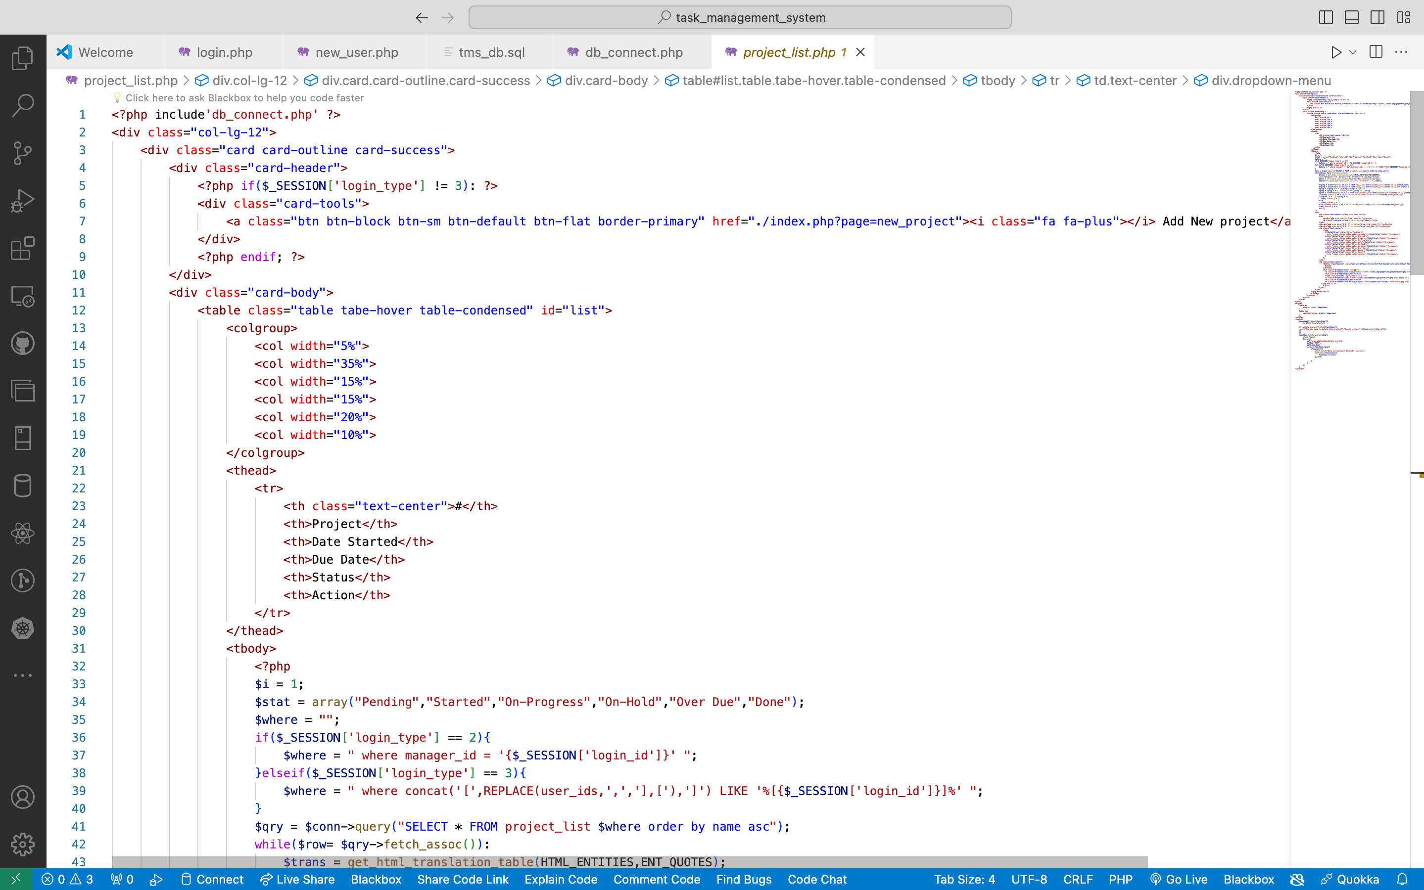
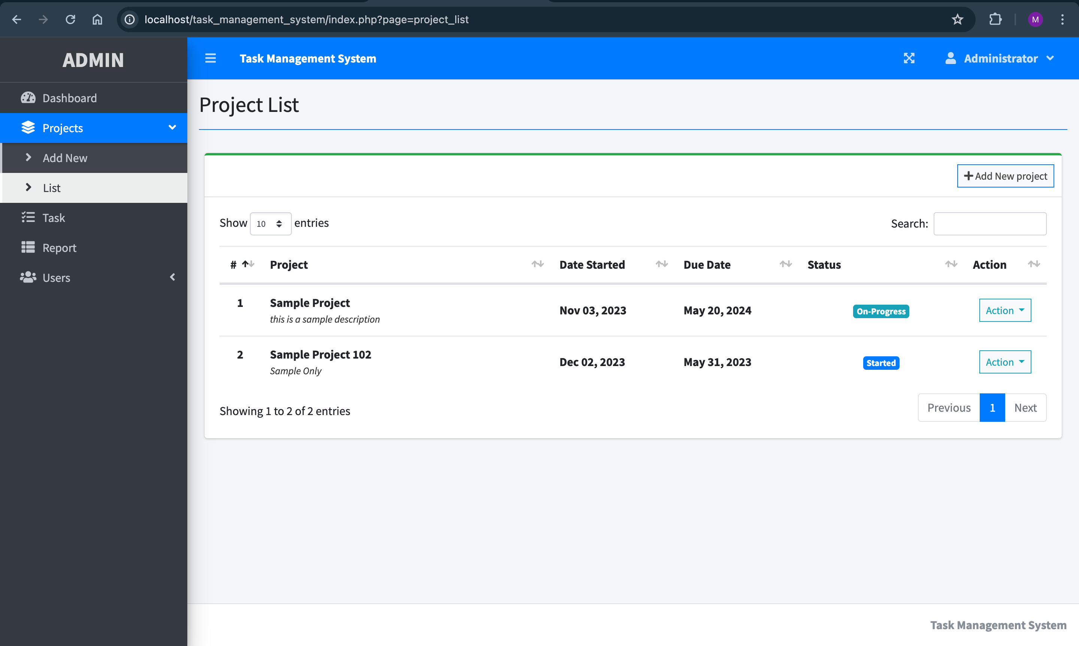
PROJECT PAGE:

Slide 18
MODULUS AND FUNCTIONALITY OF FRONT END DESIGN
1. Login Page
Secure access ensures that only authorized personnel can interact with the system, safeguarding sensitive project data.
2. Home Page
A centralized hub provides users with a quick overview of ongoing projects, pending tasks, and recent updates.
3. Project Management (CRUD Features)
Effortlessly create, read, update, and delete projects, enabling seamless project lifecycle management.
4. Task List Page
Organize tasks efficiently, facilitating prioritization and allocation based on project requirements.
5. Progress Form
Empower employees to update their task progress, fostering transparency and accountability within the team.
6. User Management (CRUD Features)
Efficiently manage user accounts, ensuring the right level of access and permissions for each team member.
7. Project Status
Track project status in real-time, enabling proactive intervention to mitigate risks and delays.

Slide 19
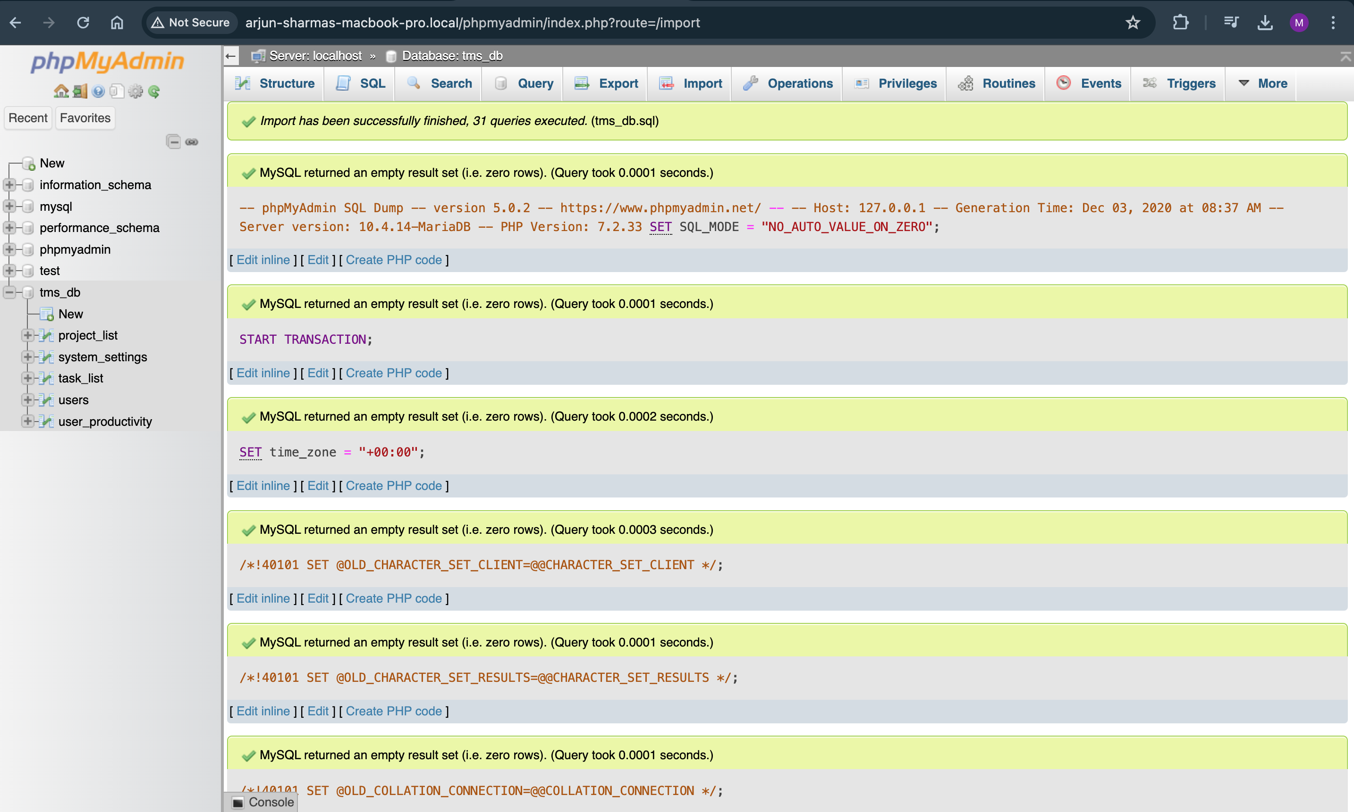
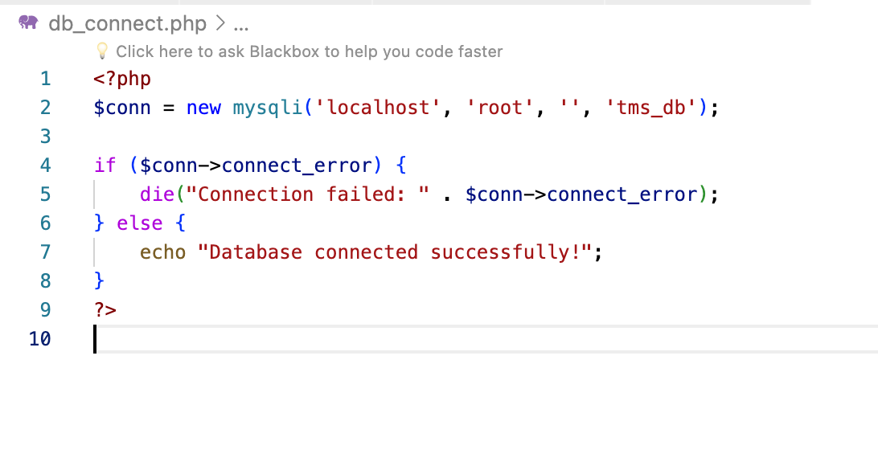
DATABASE CONNECTIVITY

Slide 20
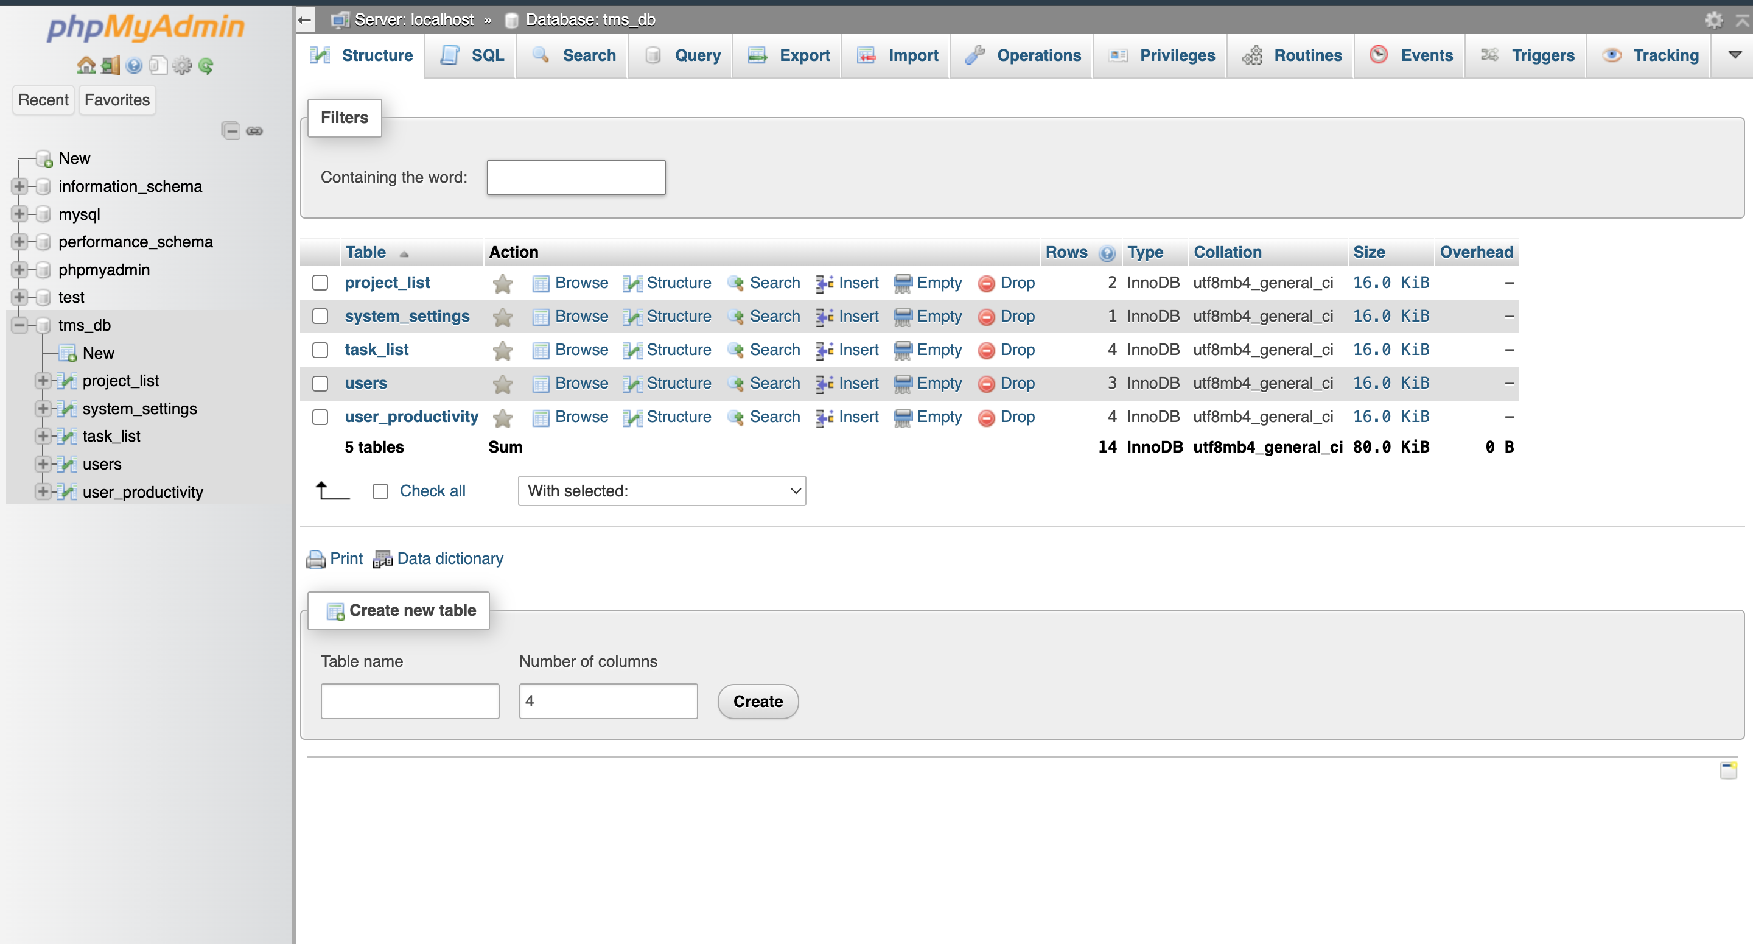
CONNECTION STRING

